Slide 1
Introduction of Machine Learning
Ashish Rai
Archit Kansal

Slide 2
Contents
What is Machine Learning
Types of Machine Learning
Supervised learning
Linear Regression
Cost Function
Gradient Descent
Learning Rate
Vectorized Implementation
Input vs Feature

Slide 3
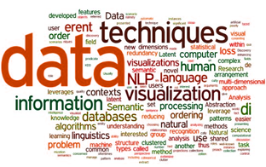
WHY MACHINE LEARNING

Slide 4
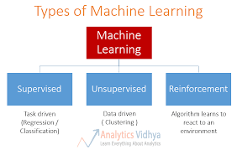
TYPES OF MACHINE LEARNING

Slide 5
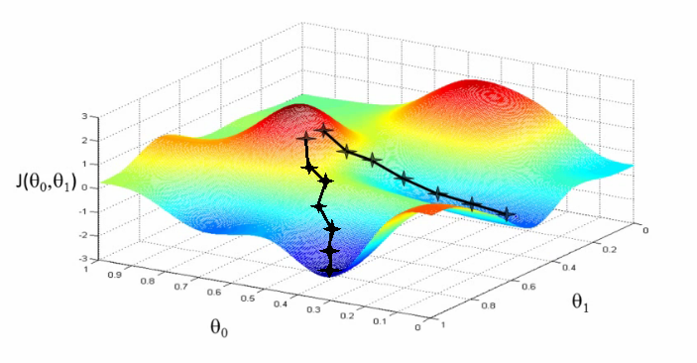
GRADIENT DESCENT ALGORITHM

Slide 6
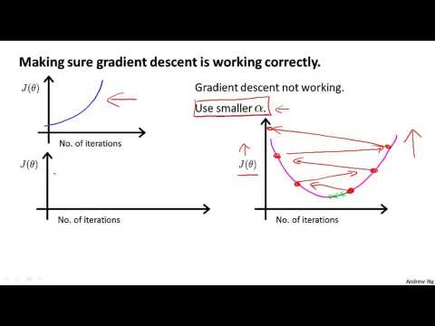
CHOOSING PROPER LEARNING RATE

Slide 7
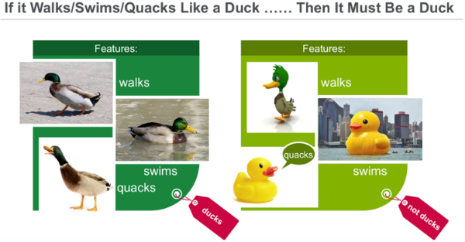
EXAMPLES OF MACHINE LEARNING

Slide 8
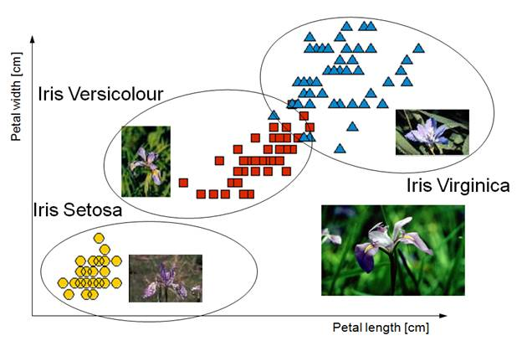
EXAMPLES OF MACHINE LEARNING

